Slide 1

Welcome

Slide 2
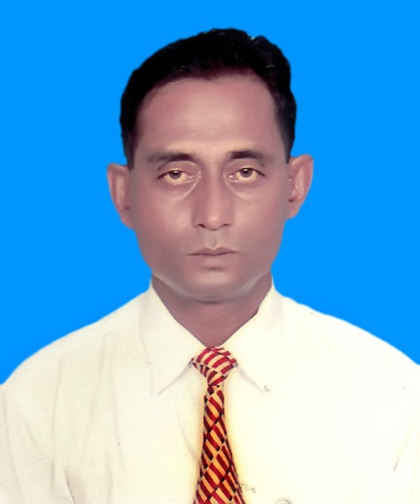
IDENTITY:
Sarder Mahfuz Aziz
Assistant Teacher (English )
T, A, Faruque School & College
Mongla.
Class : viii
Subject: English 1st Paper(UNSEEN PASSAGE)
Time : 50 Minutes

Slide 3


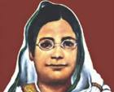
Look at the pictures :
JIVANANANDA DAS
RABINDRANATH TAGORE
BEGUM ROKEYA

Slide 4
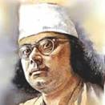
KAZI NAZRUL ISLAM

Slide 5
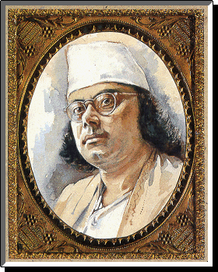
TODAY’S LESSON:
“KAZI NAZRUL ISLAM”

Slide 6
LEARNING OUTCOMES:
    Students will be able to
Read and understand the passage
Ask and answer questions
Write true /false
Fill in the blanks in a table

Slide 7
JOINING ARMY
BIRTH
1899
1917
BRING TO BANGLADESH
DEATH
1976
1972

Slide 8
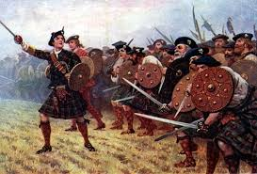
WORD MEANING:
Battle
war

Slide 9


Teacher
Instructor
Demise
Death

Slide 10
LOUD READING :
Our national poet , Kazi Nazrul Islam was born in 1899 in India . He completed his primary education in1909 and joined a local Maktab as a teacher in the same year . Again he admitted in various Educational Institutions . While he was a student of class ten in 1917 , he joined the Army . After the Second World War , Nazrul came back to Calcutta in 1920 .Then he wrote poem, story, song, etc. In 1972 he was brought to Bangladesh . He lived in Bangladesh until his demise in 1976.
10/5/2017 7:06 AM

Slide 11
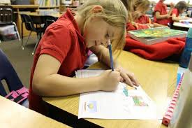
INDIVIDUAL WORK :
Write True or False :
a)Nazrul studied up to class ten .---
b)He was born in Bangladesh .--- c)He was brought to Bangladesh before independence.---
d)He died at the of 77.---
e)He wrote only poem .---
True
False
False
True
False

Slide 12
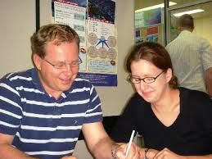
PAIR WORK:
Fill in the gaps in the given table:
Who/What | Event/Activity | When /Time | Where/Place
Kazi Nazrul Islam | i) –------------ | 1899 | ii)_________
He | Completed primary education | iii)------------------
He | Was brought to Bangladesh | iv)------------------
He | v)-------------- | 1976
was born
in India
in 1909
in 1972
died

Slide 13

“Write the summary of the passage” .
HOME WORK:

Slide 14
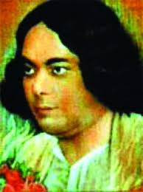

Thank you all

